Slide 1
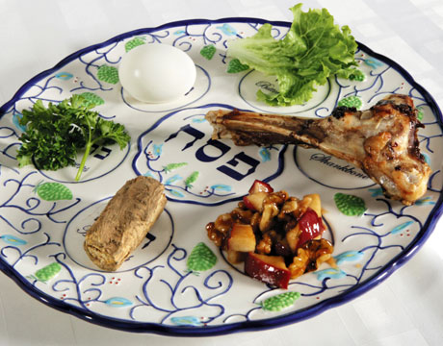
The Seder meal

Slide 2
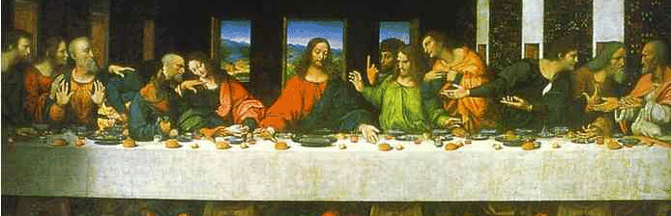
Narrator: We are gathered here to commemorate two great feasts in the history of humankind - the Jewish Passover and the Last Supper. On the last day of his life, Jesus took part in this festival meal with his disciples. It was during this meal that he gave us his body and blood with the invitation "Take and eat, drink of it, all of you." Tonight we will celebrate together a simple adaptation of the Jewish Passover meal. As a symbol of the warm glow of happiness which this festival brings into our home, let us begin by lighting the candles before us.

Slide 3
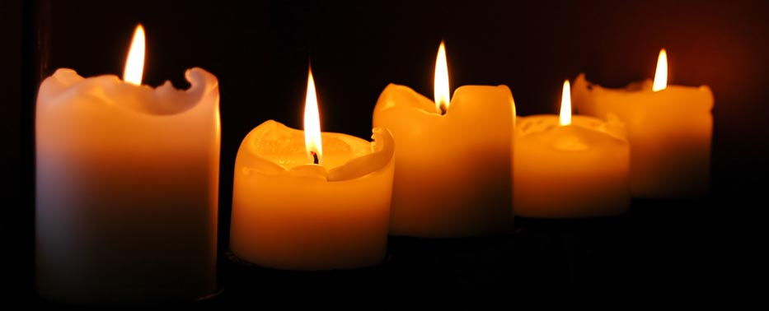
Mother of the Household: Blessed are you, Lord God, King of the Universe, Who has sanctified us with your commandments and commanded us to kindle the light of the holiday. As we light these candles help us to remember to live according to your word so that we may bring the light to others.

Slide 4
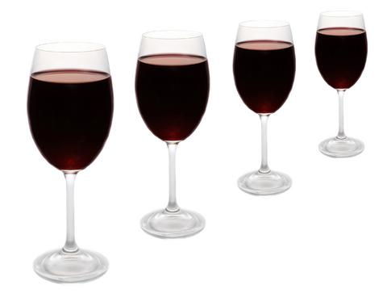
Narrator: There are four cups of wine drunk during the Seder meal to represent the four terms in the Exodus story that describe God’s saving action towards the Israelites:
Reader 1: “I am the Lord. I will FREE you from the burdens of the Egyptians and will DELIVER you from their slavery. I will REDEEM you by my outstretched arm and with mighty acts of judgment. I will TAKE YOU as my own people, and I will be your God.”
Exodus 6:6-7

Slide 5
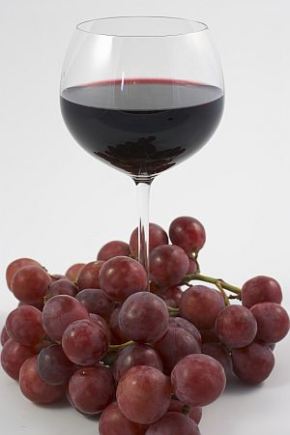
Narrator: The leader takes up the first cup of wine and recites the Kiddush, or Passover benediction:
Leader: Blessed are You, Lord God, King of the universe, who have chosen us among all peoples and sanctified us with Your commandments. In love You have given us solemn days of joy and festive seasons of gladness, even this day of the feast of the unleavened bread, a memorial of the departure from Egypt. You have chosen us for your service, You have preserved us, sustained us, and brought us to this season.
Notes:
Take a sip of grape juice

Slide 6
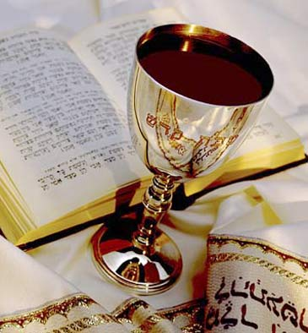
All: Blessed are You, Lord God, King of the universe, Creator of the fruit of the vine.
All drink first cup of wine.

Slide 7
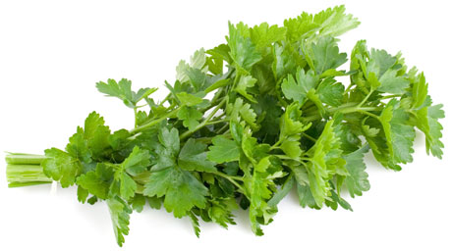
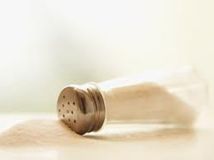
Reader 2: Passover is a spring feast. A reminder to us of the newness of life. The green herbs are now used as a token of gratitude to God for the products of the earth. We should all dip the parsley in the salt water and eat. The salt water is like the tears of a people who are bound up in slavery and are not free.

Slide 8
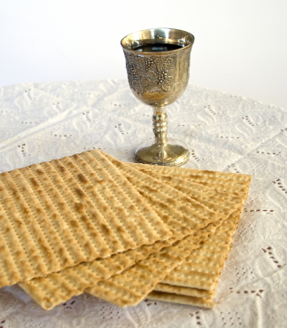
Leader: We break the middle matzah, leaving one half on the dish; the other half is hidden as the Afikoman to be eaten at the end of the meal, a reminder to the Jewish people of the hidden Messiah whose appearance is expectantly awaited.

Slide 9

Narrator: A retelling of the exodus from Egypt and the first Passover is now told. The youngest member of the family asks the 4 traditional questions –
Why is this night different from all other nights?
Why is it that on all other nights we eat all kinds of herbs, but on this night we eat only bitter herbs?
Why is it that on all other nights we do not dip our herbs even once, but on this night we dip them twice?
Why do we lean on a pillow tonight?

Slide 10

https://www.youtube.com/watch?v=xsWh4YaD3HE

Slide 11
Exodus 12:11-14
This is how you are to eat it: with your loins girt, sandals on your feet and your staff in hand, you shall eat like those who are in flight. It is the Passover of the LORD. For on this same night I will go through Egypt, striking down every first--born of the land, both man and beast, and executing judgment on all the gods of Egypt-I, the LORD! But the blood will mark the houses where you are. Seeing the blood, I will pass over you; thus, when I strike the land of Egypt, no destructive blow will come upon you. "This day shall be a memorial feast for you, which all your generations shall celebrate with pilgrimage to the LORD, as a perpetual institution.

Slide 12
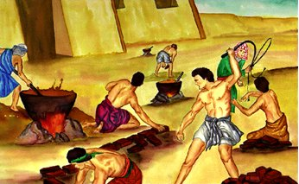
All: Why is this night different from all other nights?
Reader 3: ‘It is because of that which the Lord did for me when I came forth out of Egypt’ (Exodus 13:8). Therefore we are bound to give thanks, to praise and to bless him who did all these wonders for our fathers and for us. He brought us out from slavery to freedom, from sorrow to gladness, from darkness to great light, and from servitude to redemption.

Slide 13
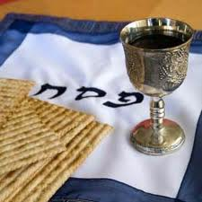
All: Blessed are You, Lord God, King of the universe, Creator of the fruit of the vine.
The second cup of wine is now drunk.

Slide 14
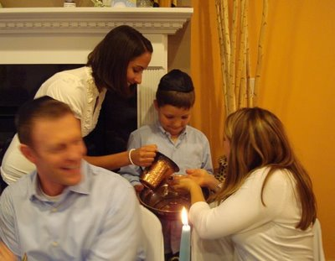
Leader: Blessed are you, Lord God, King of the Universe, who has made us holy with your commandments, and commanded us concerning the washing of the hands.

Slide 15
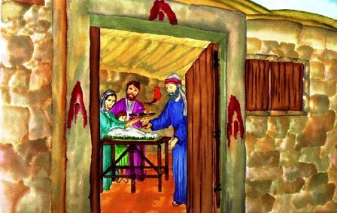
All: Why do we eat the matzah?
Reader 4: It reminds us of how the Hebrew people left Egypt in a hurry and did not have time to prepare for the trip. They had no time to bake their bread. They could not wait for the yeast to rise.

Slide 16
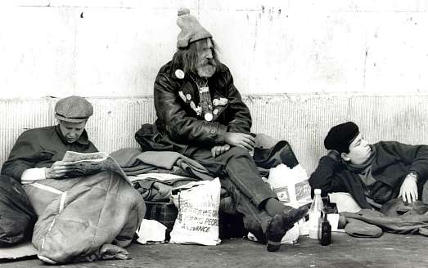
Leader: Behold, the matzah. Let it remind us of people everywhere who are poor and hungry. Let it call to our minds people today who are still enslaved and without freedom.

Slide 17
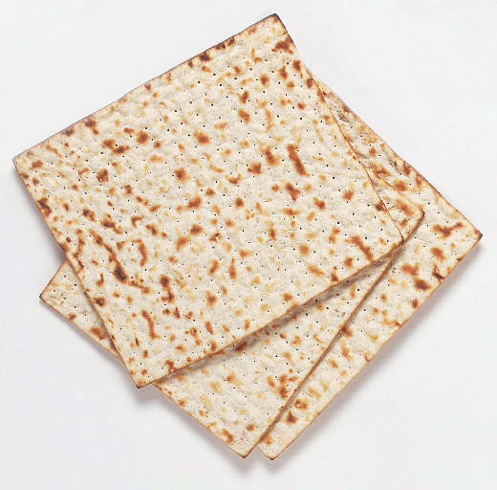
Leader: Blessed are you, Lord God, King of the Universe, who brings forth bread from the earth.
A piece of matzah is now eaten.

Slide 18
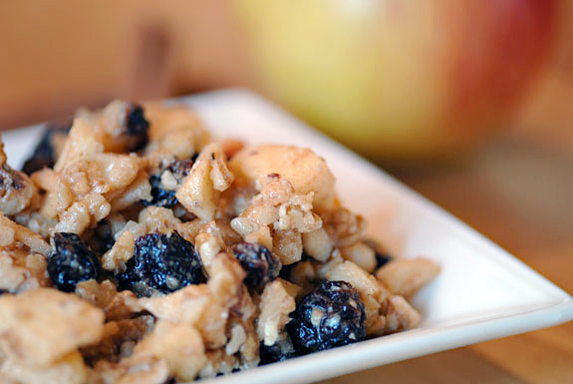
All: Why is it that on all other nights we eat all kinds of herbs, but on this night we eat only bitter herbs?
Reader 5: These bitter herbs remind us of the bitterness and suffering of slavery. (Eat a piece of matzah with some of the horseradish.) We then eat the bitter herbs with some of the charoset, a reminder of the mortar the Israelites made bricks with in Egypt. The Hebrews were able to withstand the bitterness of slavery, because it was sweetened by the hope of freedom.

Slide 19
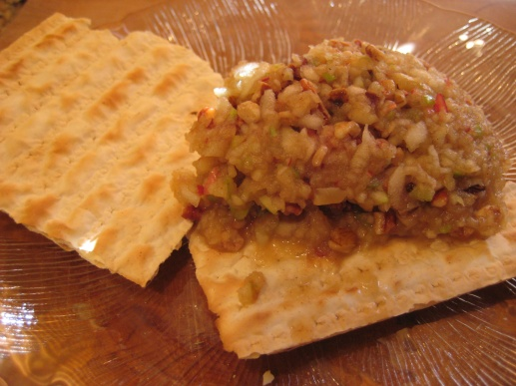
Narrator: A sandwich is now eaten made with the matzah and charoset which symbolizes mortar holding two bricks together.

Slide 20
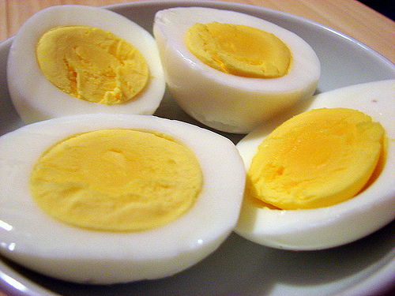
All: Why do we eat the roasted egg ?
Reader 6: The egg is symbolic of the free-will festival offering which accompanied the sacrifice of the Paschal lamb in the temple. The egg also reminds us of the new life that grows in spring.

Slide 21
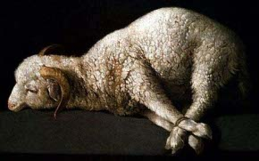
Narrator: When the temple was destroyed, the Passover lamb was no longer sacrificed because the Jewish people had no place to offer sacrifice. There is a lamb bone on the Seder meal plate to remember that sacrifice, but you are not allowed to eat lamb during the celebration.

Slide 22
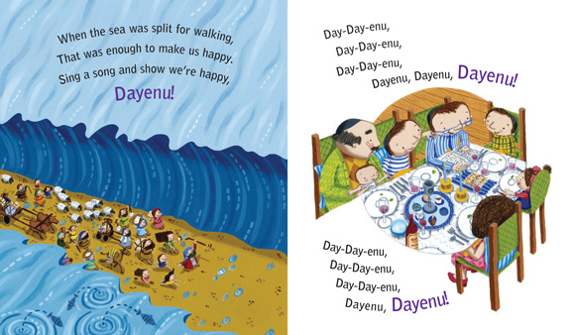
Dayenu (It Would Have Been Sufficient)
https://youtu.be/jkLzJNyDWEY

Slide 23
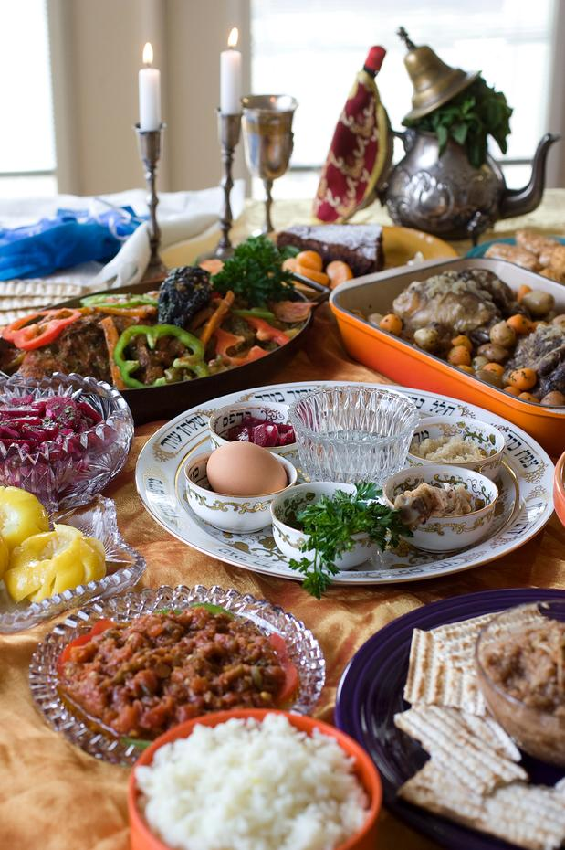
A festive meal is now eaten.

Slide 24
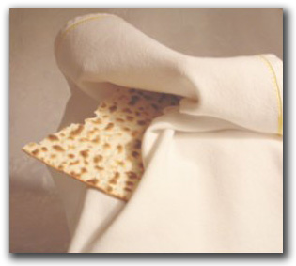
Narrator: At the end of the meal, the children look for the Afikoman , or “dessert” matzah, that was hidden at the beginning of the celebration. It was probably this second half that Christ took and blessed after the Last Supper.

Slide 25
Leader: Let us bless the Lord. (holding up matzah)
All: May the name of the Lord be blessed from now unto eternity.
Leader: Blessed are you, O Lord our God, King of the Universe, who feeds the entire world with your goodness, with grace, with loving kindness and with pity. You give bread to all flesh, for Your loving kindness endures forever. And in Your great goodness, food has not been, and shall not be lacking for us, forever and ever, for the sake of Your great name.
All: Amen
Notes:
Everyone eats the matzah

Slide 26
Leader: Let us say grace. (Lifting third cup of wine)
Let us praise Him of whose bounty we have partaken, from this time forth and for ever more. Grant us grace, mercy, life and peace on this Feast of the Unleavened Bread.
All: Amen!
Remember us this day in kindness.
All: Amen!
Visit us this day with blessing.
All: Amen!
Preserve us this day for life.
All: Amen!

Slide 27
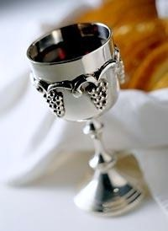
All: Blessed are you, Lord God, King of the Universe, Creator of the fruit of the vine.
The third cup of wine is now drunk.

Slide 28
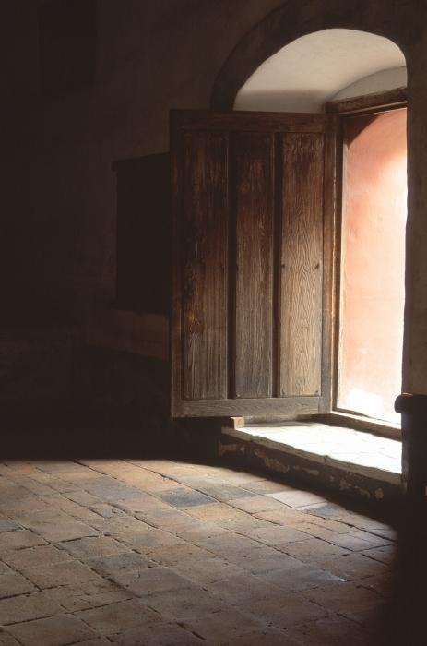
Narrator: The fourth and last cup of wine is filled. An additional cup, the Cup of Elijah the Prophet is set on the table. The Jewish people believe that the prophet Elijah will return before the Messiah comes and that he will do so during the Passover. For this reason, the door is opened for a moment at this point.

Slide 29
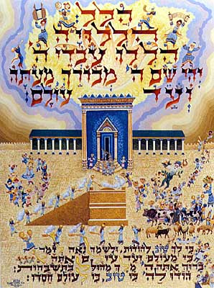
Narrator: Hallel, or Psalms 113-118, are sung to thank God for the great miracles he performed in bringing the Israelites out of slavery.

Slide 30
Hine ma tov
https://www.youtube.com/watch?v=RCzUWap9rm0
Hine ma tov
uma nayim
shevet achim gam yachad. (x2)
Hine ma tov, Hine ma tov
Lai, lai lai lai, lai lai lai lai lai (x2)
Behold how good and how pleasant it is
for brethren to dwell together. (x2)
In unity, to dwell in unity
Lai, lai lai lai, lai lai lai lai lai (x2)

Slide 31
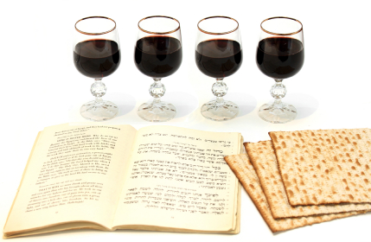
All: Blessed are you, Lord God, King of the Universe, Creator of the fruit of the vine.
The fourth cup is now drunk.

Slide 32
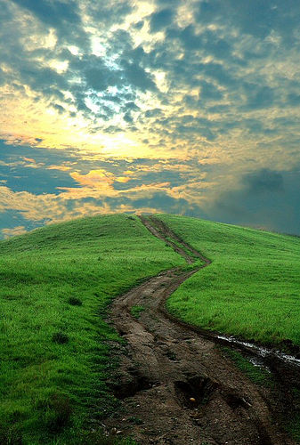
Leader: This festive service is now completed. Once again we have recited the glorious tale of Israel’s liberation from bondage. Let us pray that all people, freed from violence and from wrong, and united in an eternal covenant will celebrate a universal Passover in the name of the God of Freedom.

Slide 33

Leader: May the Lord bless us and watch over us and may the light of His countenance shine upon us and be gracious unto us.
All: Amen!

